Slide 1

Tweets Sentiment Analysis
Natural Language Processing Project

Slide 2


Introduction
A large amount of unstructured data is generated today.
Unstructured data requires some processing to generate useful insights.
The process of analyzing natural language and making sense out of it falls under the field of Natural Language Processing (NLP).
Sentiment analysis is a common NLP task, which involves classifying texts or parts of texts into a pre-defined sentiment. it is identifying an attitude of the author on a topic that is being written about.

Slide 3

Project Scope
Generally, this project aim to produce a model that can simply predict if a tweet content is positive or negative.
A model is a description of a system using rules and equations.
First, prepare a dataset of sample tweets from the NLTK package for NLP with different data cleaning methods.
Once the dataset is ready for processing, train a model on pre-classified tweets (labeled data). So t is a supervised learning machine learning process.
Use the model to classify the sample tweets into negative and positives sentiments.

Slide 4

NLTK Package
NLTK (Natural Language Toolkit) is a leading platform for building Python programs to work with human language data.
It provides easy-to-use interfaces to over 50 corpora and lexical resources such as WordNet, along with a suite of text processing libraries for classification, tokenization, stemming, tagging, parsing, and semantic reasoning and more.
NLTK is a free, open source, community-driven project.

Slide 5
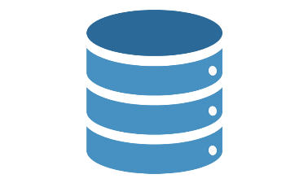
Dataset
NLTK's Twitter corpus currently contains a sample of 20k Tweets (named 'twitter_samples') retrieved from the Twitter Streaming API, together with another 10k which are divided according to sentiment into negative and positive.
We can summarized the used dataset as follows:
negative_tweets.json: 5000 tweets with negative sentiments.
positive_tweets.json: 5000 tweets with positive sentiments.
tweets.20150430-223406.json: 20000 tweets with no sentiments.

Slide 6

Project Implementation

Slide 7

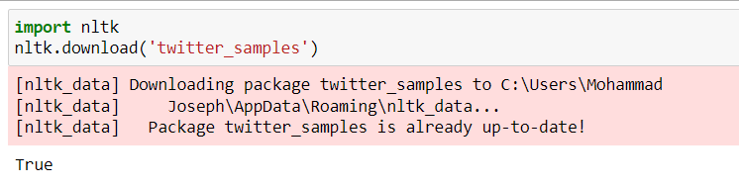
Import NLTK & Download Dataset
After install NLTK package (nltk == 3.3), import the NLTK module.
Download twitter_samples from the NLTK package.
Running the download command, downloads and stores the tweets locally.
Once the samples are downloaded, they are available for use.

Slide 8


Data Preprocessing: Tokenization
We need to process language to make it easier for the machine to understand.
Tokenization or splitting strings into smaller parts called tokens, is the first part of making sense of the data. A token is a sequence of characters in text that serves as a unit.
A basic way of implementing Tokenization is by splitting the text based on whitespace and punctuation.
First import the twitter_samples so we can work with that data:

Slide 9

Data Preprocessing: Tokenization
Declare negative_tweets,positive_tweets and text variables.
Set each tweets collection as a variable in order to make processing and testing more easier.
Use strings() method of twitter_samples to print all the tweets within a dataset as strings.

Slide 10
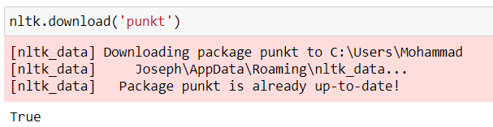
Data Preprocessing: Tokenization
We need to download an additional resource, punkt before using a tokenizer in NLTK.
The punkt module is a pre-trained model that helps in tokenize words and sentences.
Once the download is complete, we are ready to use NLTK’s tokenizers.

Slide 11
Data Preprocessing: Tokenization
Create an object that tokenizes the positive_tweets.json
tokenized()method is a default tokenizer for tweets provided by NLTK.

Slide 12
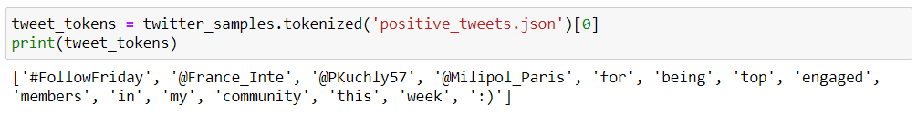
Data Preprocessing: Tokenization
To test the tokenized()method, we can tokenize a single tweet from the positive_tweets.json as following:
The process of tokenization takes some time because it’s not a simple split on white space.
The tokenized()method returns special characters such as @ and _. These characters will be removed through regular expressions

Slide 13
Data Preprocessing: Normalization
Normalizing the data, is the process of converting a word to its canonical form. Normalization helps group together words with the same meaning but different forms.
There are two popular techniques of normalization, stemming and lemmatization.
Stemming is a process of removing affixes from a word, it is a heuristic process that removes the ends of words.
The lemmatization algorithm analyzes the structure of the word and its context to convert it to a normalized form.

Slide 14
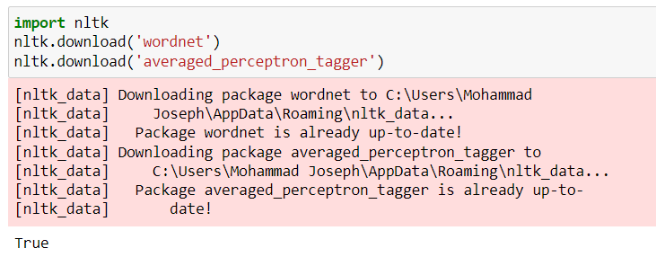
Data Preprocessing: Normalization
To use lemmatization, should download the necessary resources.
Wordnet is a lexical database for the English language that helps the script determine the base word.
The averaged_perceptron_tagger resource to determine the context of a word in a sentence.

Slide 15
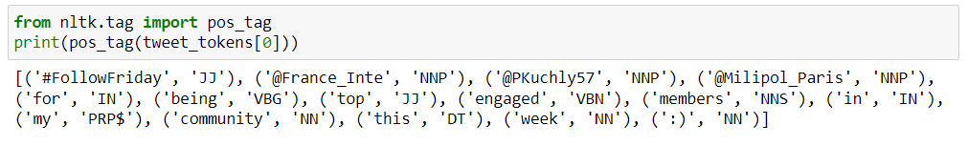
Data Preprocessing: Normalization
Once downloaded, we are almost ready to use the lemmatizer. But we need to determine the context for each word in the text. This is achieved by a tagging algorithm, which assesses the relative position of a word in a sentence.
Test pos_tag with tweet_tokens[0]:

Slide 16
Data Preprocessing: Normalization
The list of the most common items and their meaning are:
NNP: Noun, proper, singular
NN: Noun, common, singular or mass
IN: Preposition or conjunction, subordinating
VBG: Verb, gerund or present participle
VBN: Verb, past participle

Slide 17
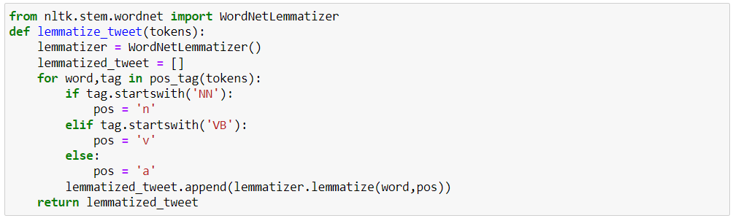
Data Preprocessing: Normalization
Import the WordNetLemmatizer class and initialize it to a variable, lemmatizer.
The function lemmatize_sentence first gets the position tag of each token of a tweet. Within the if statement, if the tag starts with NN, the token is assigned as a noun. Similarly, if the tag starts with VB, the token is assigned as a verb.

Slide 18
Data Preprocessing: Removing Noise
Removing noise from the data is important for removing any part of the text that does not add meaning or information to data, In this model we will remove 3 types of noise:
Hyperlinks - All hyperlinks in Twitter are converted to the URL shortener t.co. Therefore, keeping them in the text processing would not add any value to the analysis.
Twitter handles in replies - These Twitter usernames are preceded by a @ symbol, which does not convey any meaning.
Punctuation and special characters - While these often provide context to textual data, this context is often difficult to process. For simplicity, you will remove all punctuation and special characters from tweets.

Slide 19
Data Preprocessing: Removing Noise
We will remove these noise by a remove_noise() function that removes noise and incorporates the normalization and lemmatization mentioned in the previous section.
The code takes two arguments: the tweet_tokens and the tuple of stop_words. then uses a loop to remove the noise from the dataset.
To remove hyperlinks, the code first searches for a substring that matches a URL starting with http:// or https://, followed by letters, numbers, or special characters. Once a pattern is matched, the .sub() method replaces it with an empty string, or " " .

Slide 20
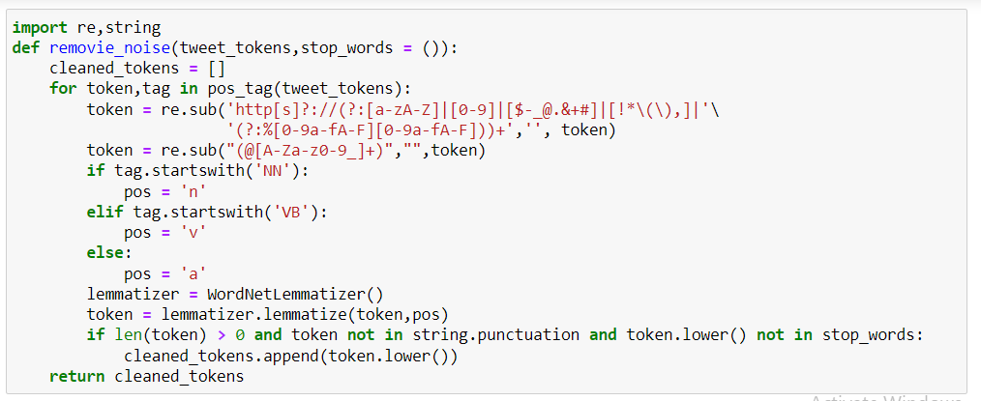
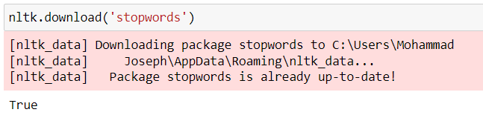
Data Preprocessing: Removing Noise
Use a built-in set of stop words in NLTK, which needs to be downloaded separately.

Slide 21
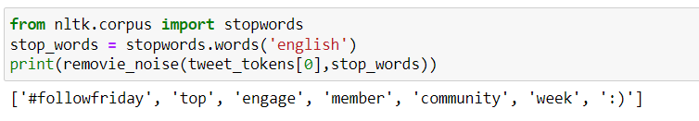
Data Preprocessing: Removing Noise
To test the function, let us run it on our sample tweet by using the .words()method to get a list of stop words in English.
Before proceeding to the modeling exercise in the next step, use the remove_noise()function to clean the positive and negative tweets.

Slide 22
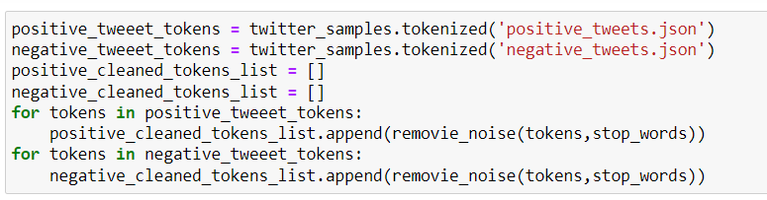
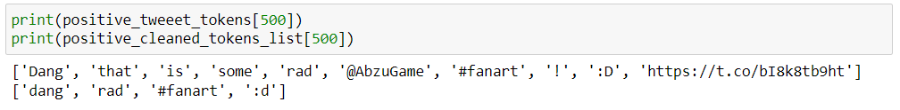
Data Preprocessing: Removing Noise
Finally , let’s compare the original tokens to the cleaned tokens for a sample of positive tweet.

Slide 23
Data Preprocessing: Word Density
…

Slide 24
Data Preprocessing: Word Density
….

Slide 25

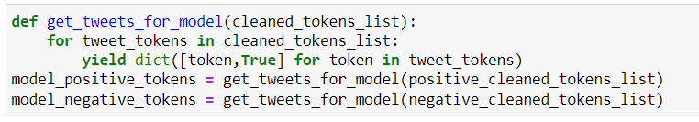
Preparing Data for the Model: Tokens to Dictionary
First, prepare the data to be fed into the model. notice that the model requires not just a list of words in a tweet, but a Python dictionary with words as keys and True as values.
The following function makes a generator function to change the format of the cleaned data.
Add the following code to convert the tweets from a list of cleaned tokens to dictionaries with keys as the tokens and True as values. The corresponding dictionaries are stored in positive_tokens_for_model and negative_tokens_for_model.

Slide 26
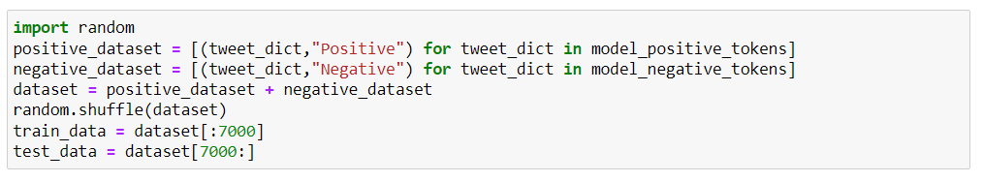
Preparing Data for the Model: Splitting Data
We still need to prepare the data for training the model.
The following code attaches a Positive or Negative label to each tweet. It then creates a dataset by joining the positive and negative tweets.
When training the model, it should be provided a sample of data that does not contain any bias. To avoid bias, add code to randomly arrange the data using the .shuffle()method of random.
Finally, the code splits the shuffled data into a ratio of 70:30 for training and testing, respectively.

Slide 27

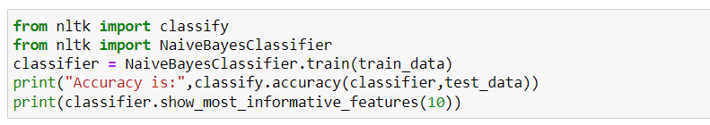
Building the Model
Use the NaiveBayesClassifier class to build the model.
Use the .train()method to train the model and the .accuracy() method to test the model on the testing data.

Slide 28
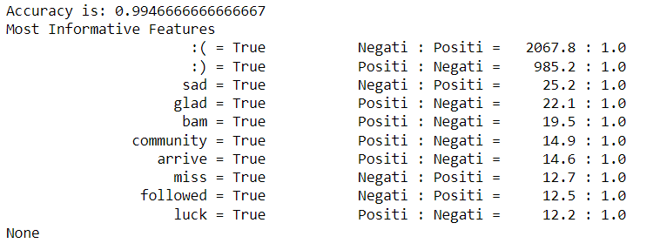
Building the Model
Accuracy is defined as the percentage of tweets in the testing dataset for which the model was correctly able to predict the sentiment. The test accuracy is 99.5% which is pretty good.
In the table that shows the most informative features, every row in the output shows the ratio of occurrence of a token in positive and negative tagged tweets in the training dataset.

Slide 29

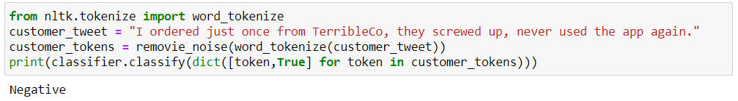
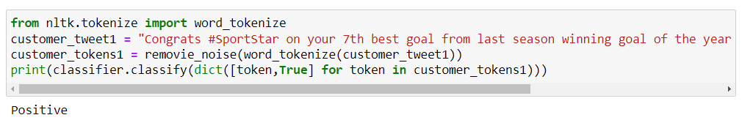
Testing the Model
Check how the model performs on random tweets from Twitter.
Test custom tweets by updating the string associated with the custom_tweet variable.
Negative Tweet:
Positive Tweet:

